Slide 1
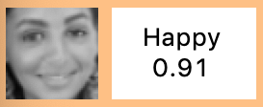
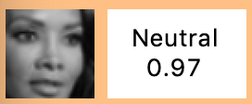
Dataset
Dataset from kaggle competition
48 x 48 Pixel grayscale images
28.709 Training-samples 7.178 Test-samples = 35.887 samples
7 Emotions as labels
Problems with the Dataset
⟺
Labeled as neutral
Labeled as happy

Slide 2
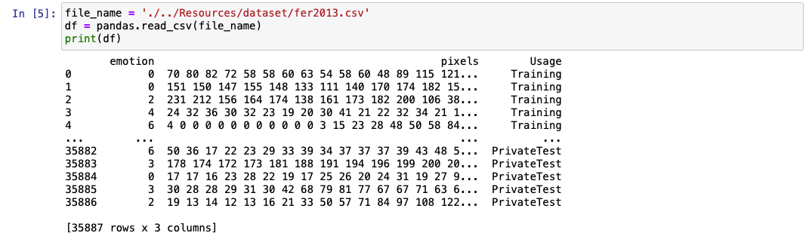

Dataset
Preparing dataset (training / test)
(48 x 48) = 2.304 dimensional input-data
$$⟹x_{n}∈{\{0,…,255\}}^{2.304}$$
Output: $y_{n}∈\left\{0,…,6\right\}$

Slide 3
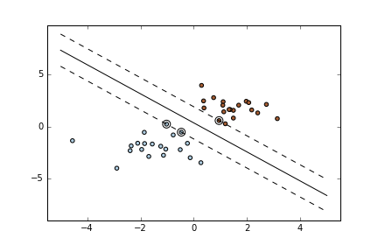
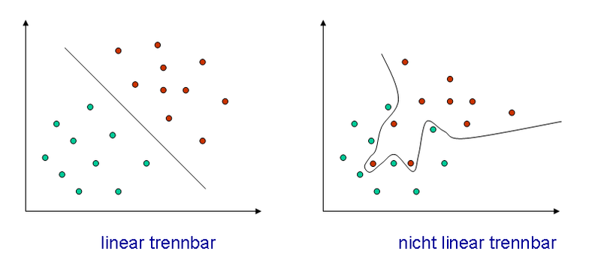
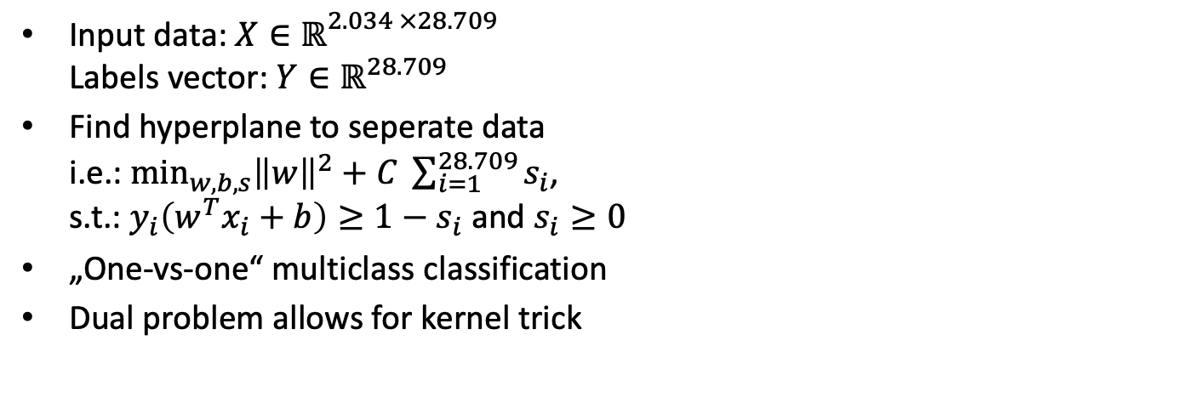
SVM– General Idea
Input data: $X∈ℝ^{\begin{aligned}2.034 ×28.709 \\ \end{aligned}}$ Labels vector: $Y∈ℝ^{28.709}$
Find hyperplane to seperate data i.e.: $\min_{w, b, s}{{\left\|w\right\|}^{2}+C \sum_{i=1}^{28.709}{s_{i}}}$, s.t.: $y_{i}\left(w^{T}x_{i}+b\right)≥1−s_{i}$ and $s_{i}≥0$
„One-vs-one“ multiclass classification
Dual problem allows for kernel trick

Slide 4
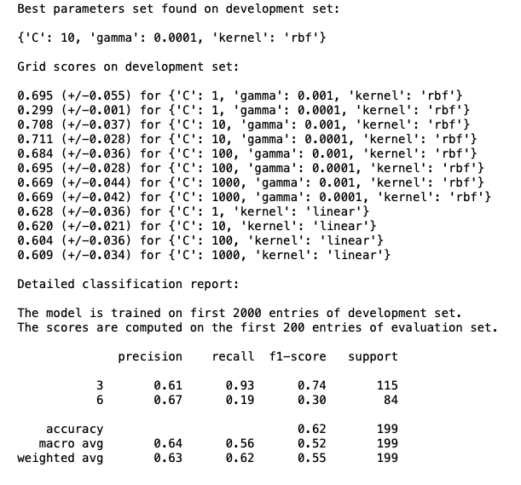

SVM – Parameter Choice
import Scikit-learn
Grid search
Cross-validation
Best parameter choice: Kernel = $exp⁡(−γ{\left\|x−y\right\|}^{2})$ $C$ = 10, $γ$ = 0.0001

Slide 5
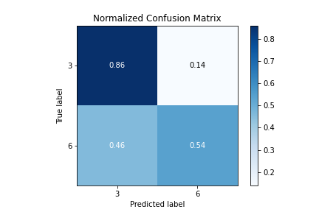
SVM
Accuracy of 42,7% for all 7 classes
Accuracy of 56,7% for happy / sad /neutral
Accuracy of 73% for happy / neutral

Slide 6
Comparison
 | KNN | Adaboost | SVM | CNN
7 Emotions | ??? | 36,4 % | 42,7 % | 62 %
Happy / Sad / Neutral | ??? | 56,7 % | 56,7 % | 78 %
Happy / Neutral | ??? | 73,3 % | 73 % | 91 %

Slide 7
Responsibilities
Name | Tasks / Roles
Max | Project Manager, Git introduction, SVM implementation, SVM documentation, dataset
Gulia | Documentation of goals and progress, general machine learning documentation, dataset
Jonas | NN implementation, NN documentation, GUI, dataset
Timo | Decision Trees, adaboost implementation, dataset
John | KNN documentation, KNN implementation, dataset

Slide 8
Quellen Bilder:
All pictures are free for non-commercial use.
Deckblatt: https://commons.wikimedia.org/wiki/File:Emotion_Recognition_Deficit.jpg
Agenda:
https://commons.wikimedia.org/wiki/File:Hey_Machine_Learning_Logo.png
Intro:
https://commons.wikimedia.org/wiki/File:5th_Floor_Lecture_Hall.jpg
https://www.pikist.com/free-photo-sobwr
SVM:
https://de.wikipedia.org/wiki/Datei:Diskriminanzfunktion.png
Project:
Product:

